Slide 1



Slide 2



Slide 3

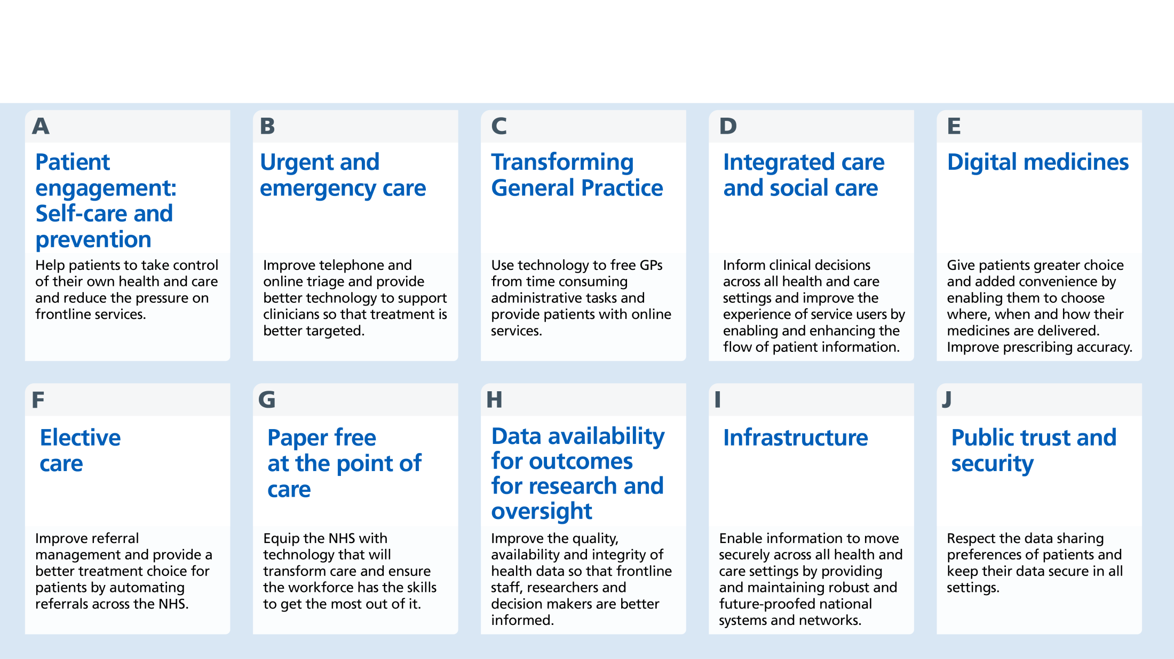

Slide 4

Context – we are all iterating – but are we clear on where we are trying to get to
What is the target architecture that will enable us to:
bring care information together for that patient in real-time
create semantically normalised view for citizen/professional
compare against a population in real-time
To enable more precise intervention for patients as part of their direct care
Approach for Summit - put existing/historic constraints to one side. Be Radical.
This is about taking a step-back and outlining the end-state and what are the levels of aggregation needed to enable this
This is not just a rehersal of what we already know
Continuously push boundaries of thinking through the summit
This is not about the granular techinical detail but the overall/meta-architecture
Notes:
Care information included that from the patient as well as the service

Slide 5


What are the objectives that the target architecture needs to provide for different stakeholder groups…
enabling MDT working across an integrated locality team
Collaborative care-planning across the team, and with the patient.
Application of best practice pathway management and adherence to clinical guidance
identify cohorts for upstream preventative care and disease management.
Work-flow management & transfers of care within and across services
Enabling triage and demand management for direct access services (primary, urgent care).
Social prescribing
Supporting / guiding patients with self-care
Access to services
Appointment booking
Getting access to my records
Managing my health conditions as a partner with my care team
Helping me to stay fit and healthy
Getting results
Finding out what services are available and relevant for my needs.
Avoiding unnecessary visits to the GP, clinic, hospital etc.
Confident about how my data is being used
Managing flow and anticipating demand in real time
Managing and allocating resources efficiently
Supporting staff to work with digital tools (inc. remote working)
Optimising medicines use
Supporting clinicians to make safe, timely and effective decisions
Understand cost-drivers
Population health need, utilisation and predictive modelling
Capacity and demand modelling
socio-demographic health needs analysis
Outcomes measures and performance
Developing capitated budgets
Strategic health needs analysis
Managing flow and anticipating demand in real time
Managing and allocating resources efficiently
Supporting staff to work with digital tools (inc. remote working)
Optimising medicines use
Supporting clinicians to make safe, timely and effective decisions
Understand cost-drivers

Slide 6

Enables local leadership and buy in (local human effort)
Supports evolving local service reconfiguration
Provides optimal security
Instils trust by citizens/professionals
Technical feasibility
Performance and scalability
Efficiency - avoiding unnecessary duplication
Encourages wider market ecosystem
Cost

Slide 7

What are the givens:
Capabilities that should be done once?
Standards – data format specifications, APIs, user and patient context preservation
Master demographics service
Citizen identity service
Messaging, Handling and Routing system (including Audit)
Record Locator Service - identifying patient record locations and key contacts involved in the care of a patient.
Consent management
Directory of services
What are the assumptions:
That governance, readiness, leadership are pre-requisites
That the approach is based upon an open architecture and open standards
That there is a varying maturity across health and social care services

Slide 8

What is the level of aggregation needed (national, regional, local) for:
Bringing care record information together for that patient in real-time?
Sharing of care record information with/from the citizen?
Comparing that individual with a population cohort?
Enabling services such as terminology and pseudonymisation
At what level and where should this data be held?
How do we create efficiencies in where/how the data is held?
How should we be accessing/storing this information?
As episodic documents or care record elements
Notes:
How to avoid the nuances- e.g. flags - need to say in general.
How do these different building blocks come together.
From each of the questions – what is the implications. How do these implications come together.

Slide 9

How to structure the session?
What are the hypothesis/key questions that we can use to test out the architecture?
Recognise that there will be nuances and intricacies but this is about the broad direction

Slide 10

What is the governance level that information sharing for direct care should occur and be aligned to the care workflow?
The STP should be the level of “regional information sharing” - this aligns with patient flow and population size (unless justified reason why not - e.g. STP boundaries artificial or super-STP level appropriate).

Slide 11

At what level should the data for information sharing provided to and with professionals be held?
National
Regional
Local
Assumptions:
Clinical systems will be accessing and sharing information through standards-based APIs
SSO and consistent security model in place and access through native systems
Options:
Professional access to patient information to be at a national level. Information for a patient with local additional content variations dealt with at a local level
Professional access to patient information to be at a regional level and then federated and normalised on demand
Options:
Information accessed as care record elements (move away from document-centric) approach

Slide 12

At what level should the information about a citizen/from a citizen be exposed?
National
Regional
Local
Assumptions:
Citizen facing apps/systems will be accessing and sharing information through standards-based APIs
SSO and consistent security model in place and access through native systems
Options:
Information for citizens to be held at a national level
Information for citizens should be held at a regional level and then federated and normalised on demand
But then where should information provided by a citizen be held?
Options:
Information accessed as care record elements (move away from document-centric) approach

Slide 13

At what level should the information in comparing an individual to a population be held?
National
Regional
Local
Assumptions:
IG model and rules in place for sharing information for population health to enable direct intervention
Options:
Information for population health held at a regional level and normalised at a regional level with the ability to bring together at national level
Information for population health should be held at a national level with direct extract from clinical systems/regional exchanges
Options:
Information accessed as care record elements (move away from document-centric) approach

Slide 14

How do the decisions for information sharing, citizen access and contribution and population health come together coherently?

Slide 15

National population health management approach
Citizen access and contribution approach
Regional information sharing exchanges
Regional information sharing exchanges
Regional information sharing exchanges
Regional information sharing exchanges

Slide 16


I can access my patients records when and where I need to
I am alerted when one of my patients has an adverse event
I work as part of a team
I am in control of my information and how it is used
I can access care at a time, place and way that suits me
I can share my patients’ care appropriately
I know which of my patients may be at risk
Technology supports and empowers my decisions
I can manage my own long term conditions safely
My Care is personal to me
Health & Care
Professional
Business Capabilities
Management Capabilities
Patient Record Access
Patient Care Planning
Integrated Workflow (tasks & alerts)
Health Surveillance
Decision Support
Population Health
Risk Stratification
Point of Care Access
Mobile Working
Caseload Management
Risk Based alerting ( eg NEWS)
Adverse Event Management
Self Management
Payment
Service Planning
Pro-active health management
Local Business Knowledge
National Standards
National Technical Capabilities
Changing roles
Directory of Service
Portal Access
App Support
Care Co-Ordination and Planning
Condition Management (eg Diabetes)
SCR
Patient/
Citizen
Data Management
PDS
Citizen Provided
Diagnostics
Social Care
Acute/ Community/ Mental Health
Primary Care
Clinical Content (eg e-Discharge)
Personalised Medicine (Genomics)
Security Standards
eRS
Technical Capabilities
Governance Standards
Spine Record Locator
Citizen Identity
Gov.uk/verify
Information Broker/Integration Engine
Self Management
Clinical Coding Dataset definition
Content/ISAs/ Preferences
Master Patient
index
Information Sharing Rules
Audit
Tasks and Notifications
Document Hub
MESH
(Secure File Transfer)
Chanel Shift
Data Transfer Standards
Shared Record
Data Extraction
Security
APIs
Infrastructure
Spine
(Security Audit)
Information Sharing (Consent)
API definition
Personal Budget
SSO/In Context Launch
Publishing/ Subscription
Citizen Identity

Slide 17




National
With option 1 there are a minimum number of national services being provided with the emphasis on local development and deployment
Features:
Data is held locally and is shared via a locally hosted solution such as a shared care record
Data for population health analysis is held and accessed locally
Services such as PDS, eRS and EPS continue to be provided nationally
Infrastructure services such as MESH, NRLS and SSP, Citizen Identity are developed to support local organisations
Citizen interaction occurs at a local level in conjunction with local services and national services provided.
Assumptions:
Local organisations have the resources to ensure national level sharing of information
Local population health level databases cover a sufficient population
There are no IG related or trust issues as this is the status quo for data residency
That the cost will be acceptable to local organisations
Local
EPR
Pop Health
Other Local

Slide 18

Other Local
With option 2 there is a set a core national services .
Features:
Data is held locally with a copy of all records also being stored nationally via a “national shared care record” which can be accessed by other local areas to create a record on demand. This based upon capturing of episodic documents.
Data for population health analysis is held nationally and is made accessible to the all local organisations via a new service. Normalisation occurs once.
Services such as PDS, eRS and EPS continue to be provided nationally
Infrastructure services such as MESH, NRLS and SSP, Citizen Identity are developed to support local organisations
Potential for a single national flow to support both patient record access and population health
Citizen interaction occurs at a national level in conjunction with local services and national services provided.
Assumptions:
IG issues can be resolved for such a national store of both the patient record and for population health level data
Trust issues can be resolved for the store of national data
That a scalable and performant solution can be developed at a national level
That local organisation buy in can be obtained in how this is used for local workflow
That funding would be available nationally to build a system
National
Pop Health
Local
EPR

Slide 19

With option 3 there is a mix of national, regional and local services being provided
Features:
Data is held locally and is retrieved on demand to build a longitudinal record of the patient (is this achievable?)
Data for population health analysis is held regionally and is made accessible to the local organisations which are part of that region (but can this be brought together at a national level)
Services such as PDS, eRS and EPS continue to be provided nationally
Infrastructure services such as MESH, NRLS and SSP, Citizen Identity are developed to support local organisations
Potential for a single national flow to support both patient record access and population health (can this be done in real-time using retrieval on demand regionally)
Retained local ownership of population health level data
Citizen interaction occurs at a local level in conjunction with local services and national services provided.
Assumptions:
That IG issues for a regional store of population can be resolved
That trust for regional rather than national data will be more acceptable
That a regional population health solution is feasible, scalable and performant to the needs of local organisations
Maintains buy in from local organisations
That funding can be distributed to support national systems and local infrastructure
Other Local
National
Regional
Pop Health
Local
EPR

Slide 20

Option 1:
Trust: typically local organisations hold their own data currently so the feeling of trust is high
Security: will vary across localities with differing approaches e.g. local data centre, national, cloud based services
Performance and scalability: will vary across localities
Cost: expensive locally especially when combined across England but cheap nationally
Local ownership: data for all purposes is held locally with control
Option 2:
Trust: issues exist with the storage and use of information nationally in terms of perception
Security: will be consistent and high across all data
Performance and scalability: can be managed centrally and shared across localities on demand
Cost: high national cost, low local cost
Local ownership: little local ownership and potentially reduced buy in
Option 3:
Trust: identifiable data can remain local with population level data national providing and increased perception of trust
Security: will be consistent and high across all data for national services and infrastructure used to access data
Performance and scalability: can be managed nationally for those services with support to deliver locally based upon demand in areas
Cost: high national but will benefit from a “do once” approach. Local components for access to data
Local ownership: control locally of data which is accessible and active management ability for data on pop health

